Slide 1
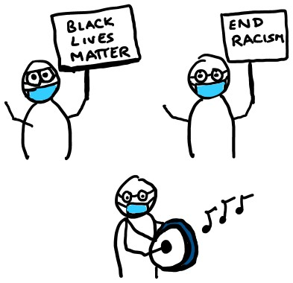

HARM REDUCTION FOR PROTESTS
IN A PANDEMIC
FOR PROTESTERS
stay home if sick
wear a mask and eye protection
maintain distance from others and keep interactions short
carry hand sanitizer
yelling can spread droplets; use signs, drums, or other noisemakers
stick with a buddy group to keep your unknown contacts low
quarantine for 14 days afterwards
FOR POLICE
stay home if sick
maintain distance from others and keep interactions short
wear a mask and eye protection
carry hand sanitizer
yelling can spread droplets; use megaphones
avoid using respiratory irritants like tear gas
avoid making crowds denser
quarantine for 14 days afterwards
@EpiEllie + @JuliaLMarcus
@EpiEllie + @JuliaLMarcus

